Slide 1
CSE 220
Jannatun Noor
Jannatun.noor@bracu.ac.bd
Lecture made by:
Aminul Haque

Slide 2
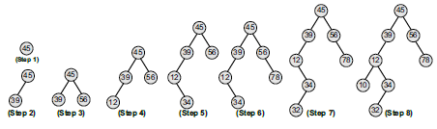
BST
Create a binary search tree using the following data elements:
45, 39, 56, 12, 34, 78, 32, 10, 89, 54, 67, 81

Slide 3
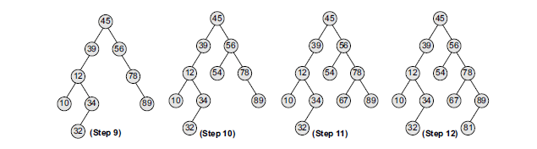

Slide 4
AVL TREES
AVL tree is a self-balancing binary search tree invented by G.M. Adelson-Velsky and E.M. Landis in 1962. The tree is named AVL in honour of its inventors. In an AVL tree, the heights of the two sub-trees of a node may differ by at most one.
The key advantage of using an AVL tree is that it takes O(log n) time to perform search, insert, and delete operations in an average case as well as the worst case because the height of the tree is limited to O(log n).

Slide 5
AVL TREES
In its structure, it stores an additional variable called the BalanceFactor. Thus, every node has a balance factor associated with it. The balance factor of a node is calculated by subtracting the height of its right sub-tree from the height of its left sub-tree.
A binary search tree in which every node has a balance factor of –1, 0, or 1 is said to be height balanced.
A node with any other balance factor is considered to be unbalanced and requires rebalancing of the tree.

Slide 6
AVL TREES
Balance factor = Height (left sub-tree) – Height (right sub-tree)
Σ If the balance factor of a node is 1, then it means that the left sub-tree of the tree is one level higher than that of the right sub-tree. Such a tree is therefore called as a left-heavy tree.
Σ If the balance factor of a node is 0, then it means that the height of the left sub-tree (longest path in the left sub-tree) is equal to the height of the right sub-tree.
Σ If the balance factor of a node is –1, then it means that the left sub-tree of the tree is one level lower than that of the right sub-tree. Such a tree is therefore called as a right-heavy tree.

Slide 7
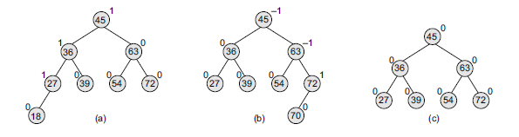

Slide 8
Heaps
A binary heap is a complete binary tree in which every node satisfies the heap property which states that:
If B is a child of A, then key(A) ≥ key(B)
This implies that elements at every node will be either greater than or equal to the element at its left and right child. Thus, the root node has the highest key value in the heap. Such a heap is commonly known as a max-heap.
Alternatively, elements at every node will be either less than or equal to the element at its left and right child. Thus, the root has the lowest key value. Such a heap is called a min-heap

Slide 9
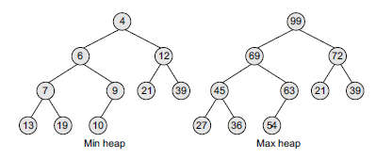

Slide 10
Inserting a New Element
Consider a max heap H with n elements. Inserting a new value into the heap is done in the following
two steps:
1. Add the new value at the bottom of H in such a way that H is still a complete binary tree but not necessarily a heap.
2. Let the new value rise to its appropriate place in H so that H now becomes a heap as well.
To do this, compare the new value with its parent to check if they are in the correct order. If they are, then the procedure halts, else the new value and its parent’s value are swapped and Step 2 is repeated.

Slide 11
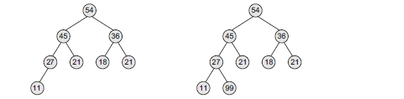
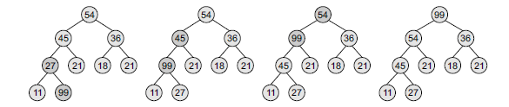
Consider the max heap given and insert 99 in it.

Slide 12
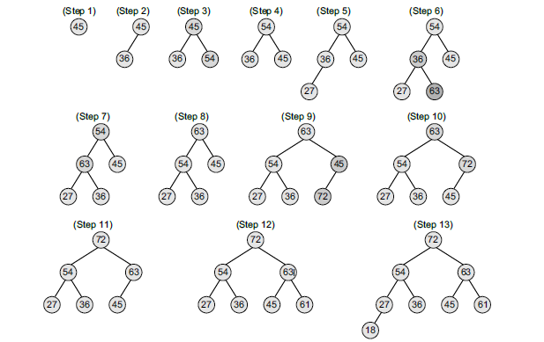
Build a max heap H from the given set of numbers: 45, 36, 54, 27, 63, 72, 61, and 18.

Slide 13
Deleting an Element
Consider a max heap H having n elements. An element is always deleted from the root of the heap. So, deleting an element from the heap is done in the following three steps:
1. Replace the root node’s value with the last node’s value so that H is still a complete binary tree but not necessarily a heap.
2. Delete the last node.
3. Sink down the new root node’s value so that H satisfies the heap property. In this step, interchange the root node’s value with its child node’s value (whichever is largest among its children)

Slide 14
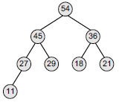
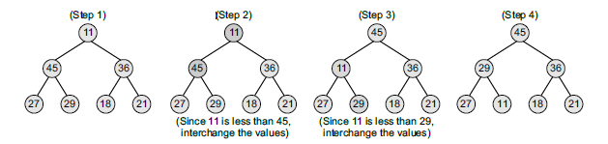
Consider the max heap H shown and delete the root node’s value.

Slide 15
Application
Used for sorting elements in heapsort
Used in priority queues
Practice
1. A heap sequence is given as: 52, 32, 42, 22, 12, 27, 37, 12, 7. Which element will be deleted when the deletion algorithm is called thrice?

Slide 16

Graphs
A graph G is defined as an ordered set (V, E), where V(G) represents the set of vertices and E(G) represents the edges that connect these vertices.
shows a graph with V(G) = {A, B, C, D and E} and E(G) = {(A, B), (B, C), (A, D), (B, D), (D, E), (C, E)}. Note that there are five vertices or nodes and six edges in the graph.

Slide 17

A graph can be directed or undirected. In an undirected graph, edges do not have any direction associated with them. That is, if an edge is drawn between nodes A and B, then the nodes can be traversed from A to B as well as from B to A.
Fig 1 shows an undirected graph because it does not give any information about the direction of the edges.
Look at the 2nd fig which shows a directed graph. In a directed graph, edges form an ordered pair. If there is an edge from A to B, then there is a path from A to B but not from B to A. The edge (A, B) is said to initiate from node A (also known as initial node) and terminate at node B (terminal node).

Slide 18
Graph Terminology
Adjacent nodes or neighbours For every edge, e = (u, v) that connects nodes u and v, the nodes u and v are the end-points and are said to be the adjacent nodes or neighbours.
Degree of a node Degree of a node u, deg(u), is the total number of edges containing the node u. If deg(u) = 0, it means that u does not belong
Regular graph It is a graph where each vertex has the same number of neighbors. That is, every node has the same degree. A regular graph with vertices of degree k is called a k–regular graph or a regular graph of degree k. Figure shows regular graphs. to any edge and such a node is known as an isolated node.

Slide 19
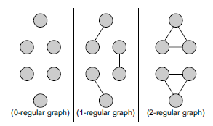

Slide 20
Graph Terminology
Path A path P written as P = {v0, v1, v2, ..., vn), of length n from a node u to v is defined as a sequence of (n+1) nodes. Here, u = v0, v = vn and vi–1 is adjacent to vi for i = 1, 2, 3,..., n.
Closed path A path P is known as a closed path if the edge has the same end-points. That is, if v0 = vn.
Simple path A path P is known as a simple path if all the nodes in the path are distinct with an exception that v0 may be equal to vn. If v0 = vn, then the path is called a closed simple path.
Cycle A path in which the first and the last vertices are same. A simple cycle has no repeated edges or vertices (except the first and last vertices).

Slide 21

Graph Terminology
Connected graph A graph is said to be connected if for any two vertices (u, v) in V there is a path from u to v. That is to say that there are no isolated nodes in a connected graph. A connected graph that does not have any cycle is called a tree. Therefore, a tree is treated as a special graph
Complete graph A graph G is said to be complete if all its nodes are fully connected. That is, there is a path from one node to every other node in the graph. A complete graph has n(n–1)/2 edges, where n is the number of nodes in G.

Slide 22
Graph Terminology
Labelled graph or weighted graph A graph is said to be labelled if every edge in the graph is assigned some data. In a weighted graph, the edges of the graph are assigned some weight or length. The weight of an edge denoted by w(e) is a positive value which indicates the cost of traversing the edge. Figure 13.4(c) shows a weighted graph.
Multiple edges Distinct edges which connect the same end-points are called multiple edges. That is, e = (u, v) and e' = (u, v) are known as multiple edges of G. Loop An edge that has identical end-points is called a loop. That is, e = (u, u).
Multi-graph A graph with multiple edges and/or loops is called a multi-graph. Figure 13.4(a) shows a multi-graph.
Size of a graph The size of a graph is the total number of edges in it.

Slide 23
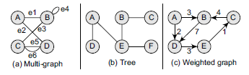

Slide 24
REPRESENTATION OF GRAPHS
There are two common ways of storing graphs in the computer’s memory. They are:
Σ Sequential representation by using an adjacency matrix.
Σ Linked representation by using an adjacency list that stores the neighbors of a node using a linked list.

Slide 25
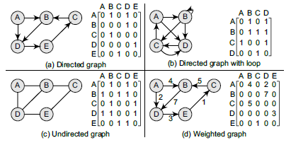
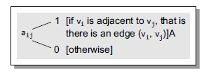
Adjacency Matrix

Slide 26
Adjacency List Representation
This structure consists of a list of all nodes in G. Furthermore, every node is in turn linked to its own list that contains the names of all other nodes that are adjacent to it.
The key advantages of using an adjacency list are:
It is easy to follow and clearly shows the adjacent nodes of a particular node.
It is often used for storing graphs that have a small-to-moderate number of edges. That is, an adjacency list is preferred for representing sparse graphs in the computer’s memory; otherwise, an adjacency matrix is a good choice.
Adding new nodes in G is easy and straightforward when G is represented using an adjacency list. Adding new nodes in an adjacency matrix is a difficult task, as the size of the matrix needs to be changed and existing nodes may have to be reordered

Slide 27
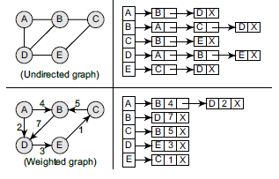


Slide 28
Terminology of a Directed Graph
Out-degree of a node The out-degree of a node u, written as outdeg(u), is the number of edges that originate at u.
In-degree of a node The in-degree of a node u, written as indeg(u), is the number of edges that terminate at u.
Degree of a node The degree of a node, written as deg(u), is equal to the sum of in-degree and out-degree of that node. Therefore, deg(u) = indeg(u) + outdeg(u).
Isolated vertex A vertex with degree zero. Such a vertex is not an end-point of any edge.
Pendant vertex (also known as leaf vertex) A vertex with degree one.

Slide 29
Terminology of a Directed Graph
Source A node u is known as a source if it has a positive out-degree but a zero in-degree.
Sink A node u is known as a sink if it has a positive in-degree but a zero out-degree.
Strongly connected directed graph A digraph is said to be strongly connected if and only if there exists a path between every pair of nodes in G. That is, if there is a path from node u to v, then there must be a path from node v to u.
Weakly connected digraph A directed graph is said to be weakly connected if it is connected by ignoring the direction of edges. That is, in such a graph, it is possible to reach any node from any other node by traversing edges in any direction (may not be in the direction they point). The nodes in a weakly connected directed graph must have either out-degree or in-degree of at least 1.

Slide 30
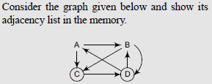
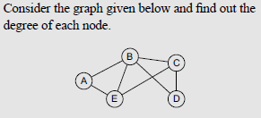
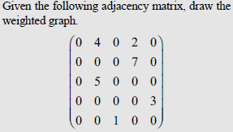
Exercise

Slide 31
Graph traversal
Given a graph G = (V,E), and a distinguished vertex s, how do you visit each vertex v ∈ V exactly once is called Graph Traversal.
There are two standard methods of graph traversal which we will discuss in this section. These two methods are:
1. Breadth-first search
2. Depth-first search
While breadth-first search uses a queue as an auxiliary data structure to store nodes for further processing, the depth-first search scheme uses a stack.

Slide 32
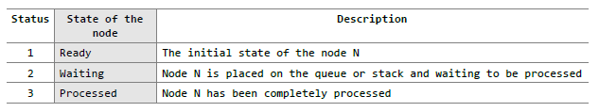
Graph traversal
Both these algorithms make use of a variable STATUS. During the execution of the algorithm, every node in the graph will have the variable STATUS set to 1 or 2, depending on its current state.

Slide 33
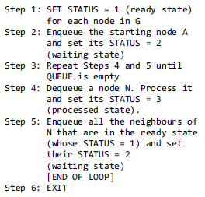
Breadth-First Search Algorithm
Breadth-first search (BFS) is a graph search algorithm that begins at the root node and explores all the neighbouring nodes. Then for each of those nearest nodes, the algorithm explores their unexplored neighbour nodes, and so on, until it finds the goal.

Slide 34
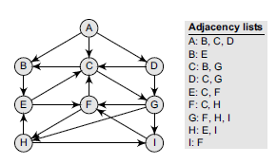
Sample Question
Consider the graph G given The adjacency list of G is also given. Assume that G represents the daily flights between different cities and we want to fly from city A to I with minimum stops. That is, find the minimum path P from A to I given that every edge has a length of 1.

Slide 35
Solution
The minimum path P can be found by applying the breadth-first search algorithm that begins at city A and ends when I is encountered. During the execution of the algorithm, we use two arrays:
QUEUE and ORIG. While QUEUE is used to hold the nodes that have to be processed, ORIG is used to keep track of the origin of each edge. Initially, FRONT = REAR = –1. The algorithm for this is as follows:

Slide 36




1. Add A to QUEUE and add NULL to ORIG.
2. Dequeue a node by setting FRONT = FRONT + 1 (remove the FRONT element of QUEUE) and enqueue the neighbours of A. Also, add A as the ORIG of its neighbours.
3. Dequeue a node by setting FRONT = FRONT + 1 and enqueue the neighbours of B. Also, add B as the ORIG of its neighbours.
4. Dequeue a node by setting FRONT = FRONT + 1 and enqueue the neighbours of C. Also, add C as the ORIG of its neighbours. Note that C has two neighbours B and G. Since B has already been added to the queue and it is not in the Ready state, we will not add B and only add G.

Slide 37


Dequeue a node by setting FRONT = FRONT + 1 and enqueue the neighbours of D. Also, add D as the ORIG of its neighbours. Note that D has two neighbours C and G. Since both of them have already been added to the queue and they are not in the Ready state, we will not add them again.
Dequeue a node by setting FRONT = FRONT + 1 and enqueue the neighbours of E. Also, add E as the ORIG of its neighbours. Note that E has two neighbours C and F. Since C has already been added to the queue and it is not in the Ready state, we will not add C and add only F.
Dequeue a node by setting FRONT = FRONT + 1 and enqueue the neighbours of G. Also, add G as the ORIG of its neighbours. Note that G has three neighbours F, H, and I.
Since F has already been added to the queue, we will only add H and I. As I is our final destination, we stop the execution of this algorithm as soon as it is encountered and added to the QUEUE. Now, backtrack from I using ORIG to find the minimum path P. Thus, we have P as A -> C -> G -> I.

Slide 38
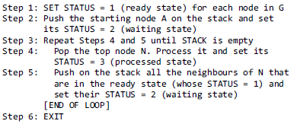
Depth-First Search Algorithm
The depth-first search algorithm progresses by expanding the starting node of G and then going deeper and deeper until the goal node is found, or until a node that has no children is encountered. When a dead-end is reached, the algorithm backtracks, returning to the most recent node that has not been completely explored.

Slide 39
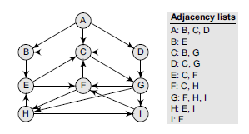

Slide 40









